Slide 1

MATH 285 Week 9
DI 2

Slide 2
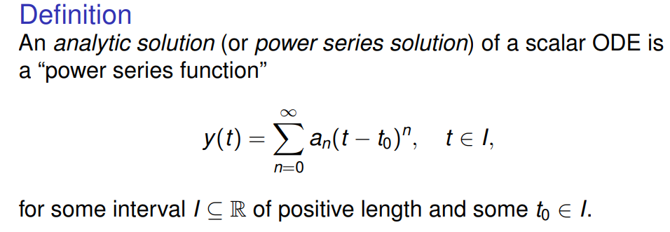
Analytic solution for ODEs

Slide 3
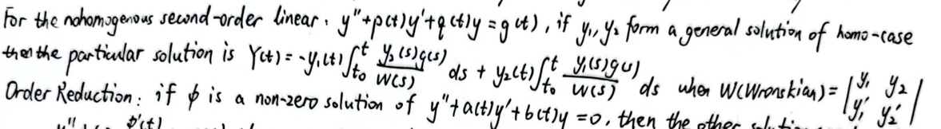
The Wronskian

Slide 4
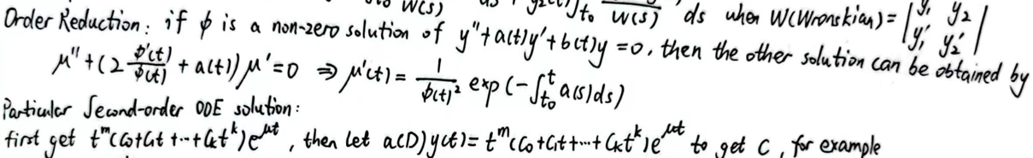
Time to Review Order Reduction

Slide 5
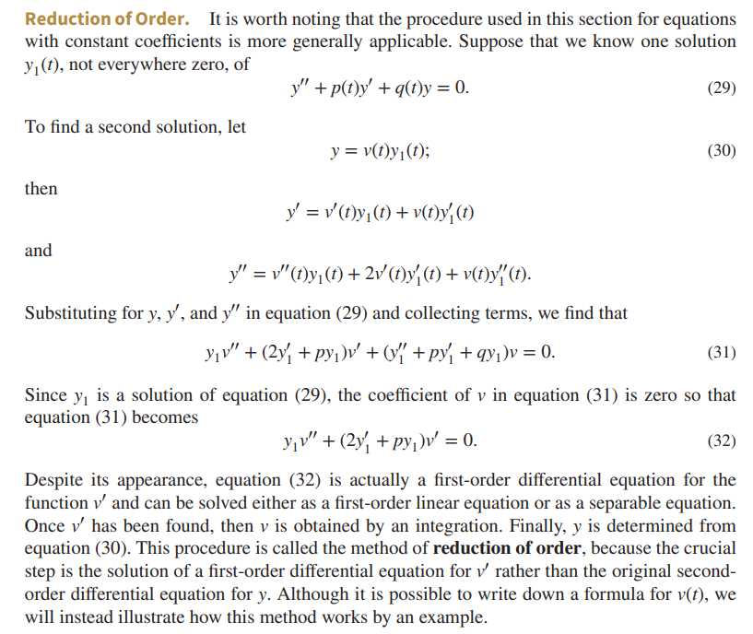

Slide 6
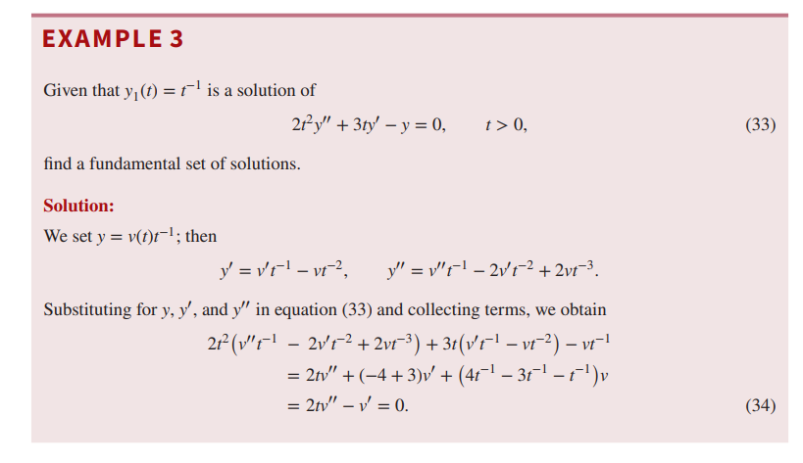

Slide 7
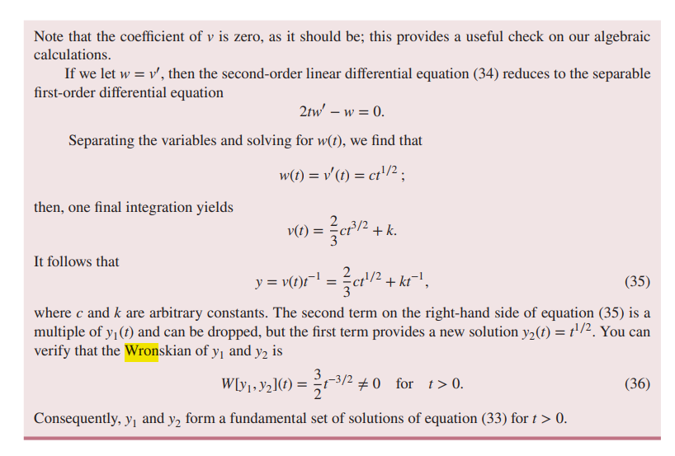

Slide 8
But How to Determine the Particular Solution?

Slide 9
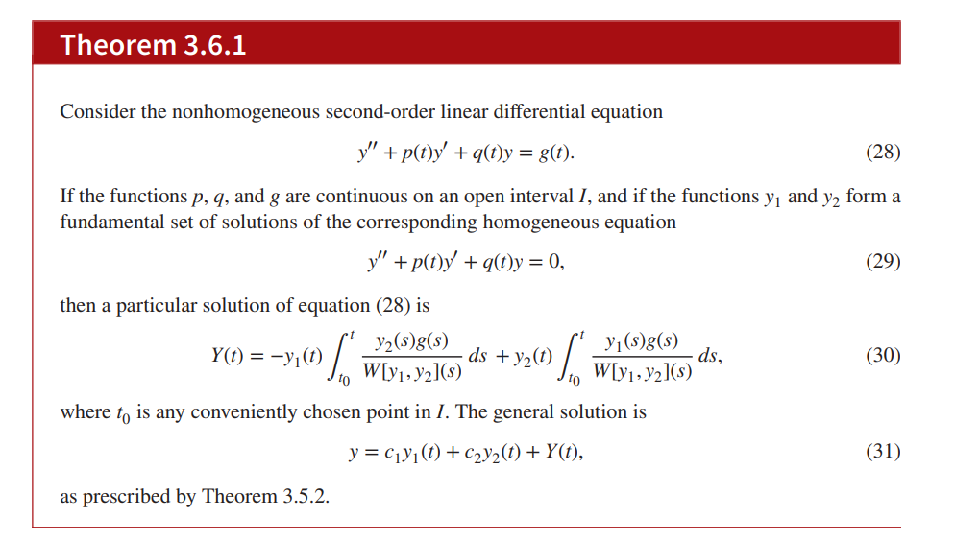
Variation of Parameters

Slide 10
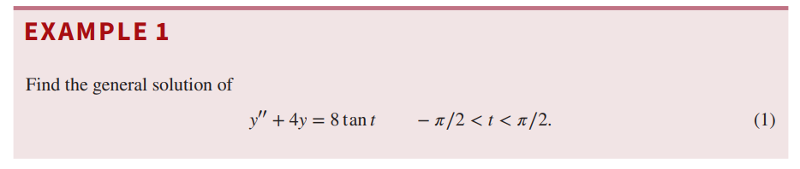
One Interesting problem (Check textbook for answer)

